Slide 3
Ubiquitin
P53 is not, by any means, the only protein that is marked for destruction by ubiquitin. As you may have guessed, ubiquitin is a ubiquitous protein in cells. It’s general role is protein turn over….making sure proteins don’t linger longer than needed.
http://en.wikipedia.org/wiki/Ubiquitin

Slide 4
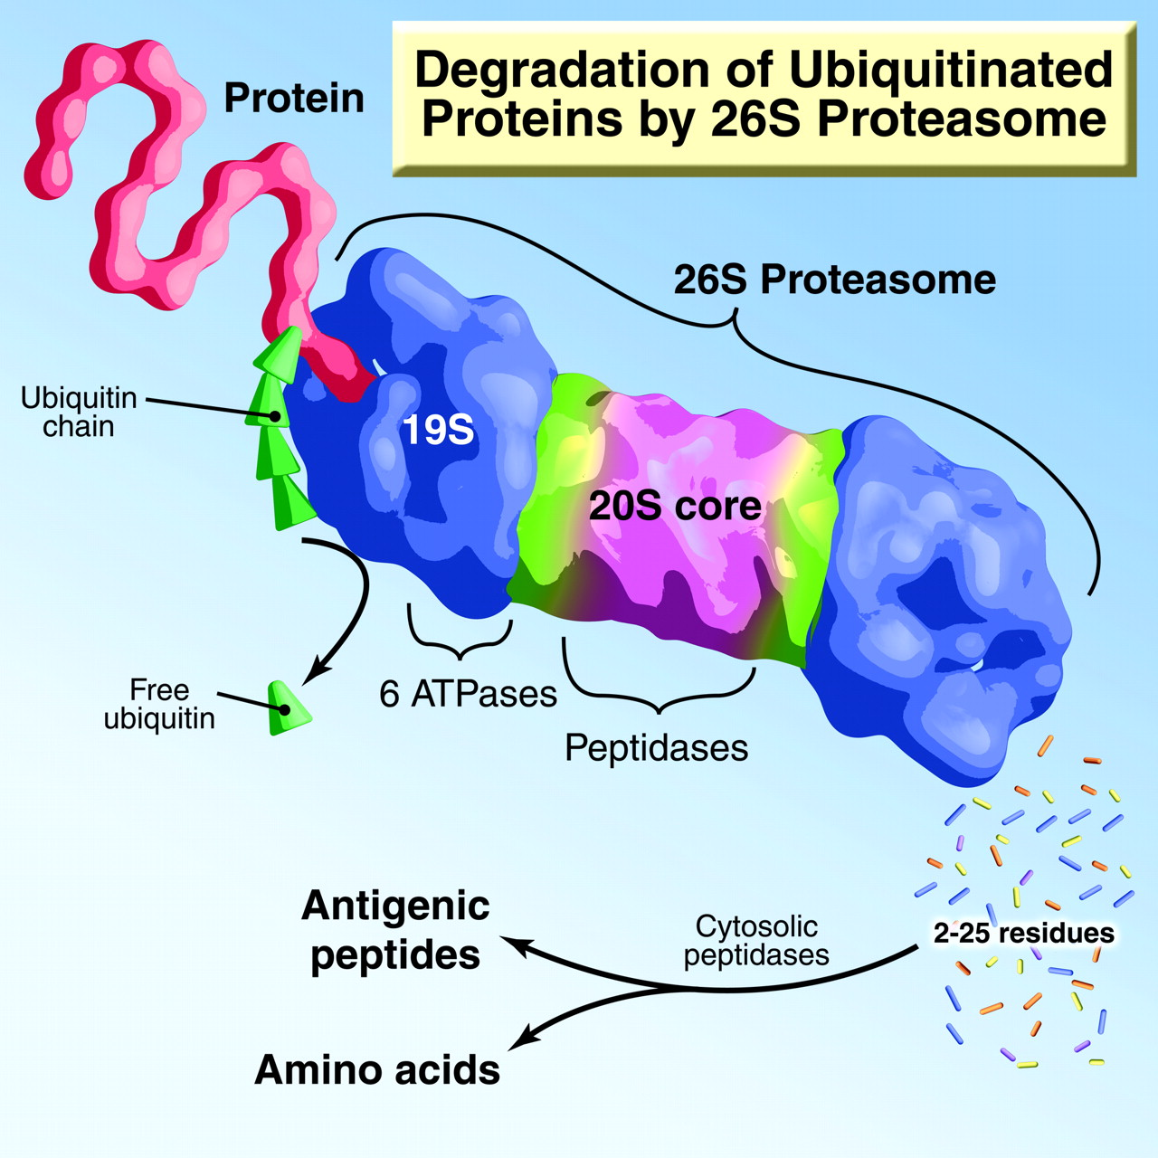
In a series of steps, ubiquitin is attached to proteins, which then marks those proteins for transport to a cellular structure called the proteosome. This is a large multiprotein complex that degrades proteins, strips of ubiquitin and recycles amino acids.

Slide 5
Addition and removal of chemical functional groups
>40 different ways in which proteins can be modified post translation
Some modifications are permanent, once they are made
Many modifications are reversible making a translated protein alternately active and inactive during the lifetime of the protein.
Recall acetylation and de-acetylation of histones! ---what is the result?

Slide 6
You just saw the one of the most common activation/deactivation mechanisms of proteins that cells use
Phosphorylation of proteins by kinases
Dephosphorylation of proteins by phosphatases.

Slide 7
HRI activation

Slide 8
In general phosphate groups alter the folding of proteins to activate or inactivate them...

Slide 9
Why?
Like other ”late” acting gene regulation mechanisms, for some proteins, posttranslational activation/inactivation makes sense! It is much “cheaper” in terms of cellular energy than expressing them from scratch (transcription) when needed.
These proteins are often needed quickly when the cell receives an external signal…

Slide 10
Can Gene regulation happen at the level of DNA?
Yes! We’ve seen examples of chromatin changes---the opening of DNA to allow access of transcription factors and RNApol….But this is really transcription regulation. Read 17-2
Amazingly, a few genes are regulated pre-transcription----at the level of the DNA.
What? ☺ I thought the genome/recipe was unchangeable, in terms of DNA sequence, once we inherited it.

Slide 11
So which proteins are we talking about…
Proteins expressed by some of our immune system cells (B-cells and T-cells) function to protect us from a huge number and variety of disease-causing infectious agents (pathogens).
For example B-cells make antibodies. (Also called B-cell antigen receptor) Each B-cell we produce makes one type of antibody that will, by chance, match a certain pathogen we may encounter one day.
i.e.---I encountered 3-4 different cold viruses this winter…

Slide 12
Antibodies are made of 4 different proteins, which assemble to make an active complex capable of binding to antigens (parts of pathogens).

Slide 13
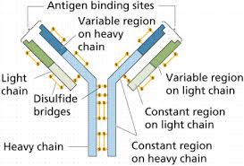

Slide 14
Antibody diversity
It is estimated that humans can make 10¹² unique antibodies. Wooooosh!
According to the central dogma, this would require 10¹² different genes with unique sequence to produce unique proteins.
This can’t be explained in terms of antibody genes---we don’t have 10¹² antibody genes. In fact we have fewer than 30,000 protein encoding genes in total!

Slide 15
Mechanism?
DNA rearrangements of just a few genes. Our antibody proteins are actually encoded by DNA arranged in gene segments.
Prior to transcription, these gene segments are cut and pasted together in random combinations.
Each B-cell will make a unique version of the antibody gene.

Slide 16
Caution…
Aspects of this process resemble alternative splicing..
Keep in mind this occurs pre-transcription! It is occurring right now in cells of your bone marrow which are developing from blood stem cells into B-cells.
Section 17.9---programmed DNA rearrangements.

Slide 18
This only occurs in B-cells and the antibody genes are only transcribed and translated in B-cells. (Think gene regulation).
Other cells, of course, have the antibody genes/gene segments, but they are left in the germline organization (as inherited) in non-B-cells, and are never transcribed.

Slide 19
T-cells do something very similar to rearrange gene segments for the genes that make up a protein complex called the T-cell receptor (TCR). (Which Beverly talked about in CAR-T-cell therapy).
T-cell receptors TCRs=Antigen receptors.
The TCR allows T-cells to bind to other cells that have been infected with pathogens (such as viruses) and to initiate the killing of these cells.
T-cells also recognize cancer cells with their TCRs.

Slide 21
Just like antibodies---for effective T-cell responses by our immune system, T-cells must make millions+ different TCRs—and again, we don’t have unique genes encoding millions of different TCR proteins.
T-cells use a very similar programmed DNA rearrangement system to combine gene segments in millions of different combinations.

Slide 22
Pre-transcription of 2 unique TCRs

Slide 23
Any other examples?
Not many---Some bacterial and protozoan pathogens/parasites, have evolved systems to outwit the host immune system.
They alter, at the DNA level, genes encoding surface proteins in an attempt to avoid recognition by antibodies.

Slide 24
The system is called Antigenic Variation.
http://en.wikipedia.org/wiki/Antigenic_variation
Again---it is an exception to the rule of the central dogma. For most organisms, for most genes, the recipe you inherit from your “parents” is unchanging.

